Slide 1
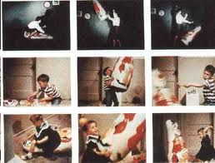

LEARNING

Slide 2
DEFINATIONS OF LEARNING
Dollard Miller: Modification of behavior due to past experience.
Learning is acquiring new knowledge, behaviors, skills, values, preferences or understanding, and may involve synthesizing different types of information.
. Learning is a relatively permanent change in behavior brought about by experience.
(From Feldman)

Slide 3
Types Of Learning
Trial Error
Insight
Imitation or Observation (Albert Bendoura)
Cognitive (E.C. Tolman)

Slide 4
Trail Error (Thorndike)
Different possible configurations are generated, after a test of their "fitness", the good ones are retained, and the bad ones or "errors" are eliminated.
Trial & error is a general method Of problem solving for obtaining knowledge, or reaching a solution by trying out various means and theories until errors are eliminated.

Slide 5
The most characteristic form of learning of both lower animals and man was identified by Thorndike as trial and error learning. A trial is defined as the length of time , a number of errors involved in single reaching of the goal.

Slide 6
Insight
. Insight learning is a type of learning or problem solving that happens all-of-a-sudden through understanding the relationships various parts of a problem rather than through trial and error.
. A type of learning that uses reason, especially to form conclusions, inferences, or judgments, to solve a problem.

Slide 7
Kohler constructed a variety of problems for the
chimps, each of which involved obtaining food
that was not directly accessible. In the simplest
task, food was put on the other side of a barrier.
Dogs and cats in previous experiments had
faced the barrier in order to reach the food, rather
than moving away from the goal to circumvent
the barrier. The chimps, however, presented with
An apparently analogous situation, set off
immediately on the circuitous route to the food.

Slide 8
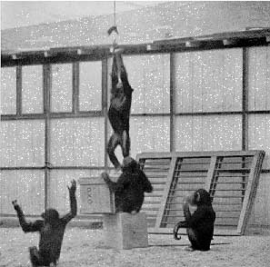

Slide 9
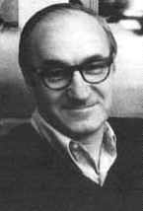
Imitation and observation (Albert Bandura)
Behaviorism, with its emphasis on
experimental methods, focuses on variables we can observe, measure, and manipulate, and avoids whatever is subjective, internal, And unavailable -- i.e. mental. Four steps are involved ,ATTENTION,RETENTION,MOTOR REPRODUCTIONAND REINFORCEMENT.
Positive role model lead to positive learning.

Slide 10
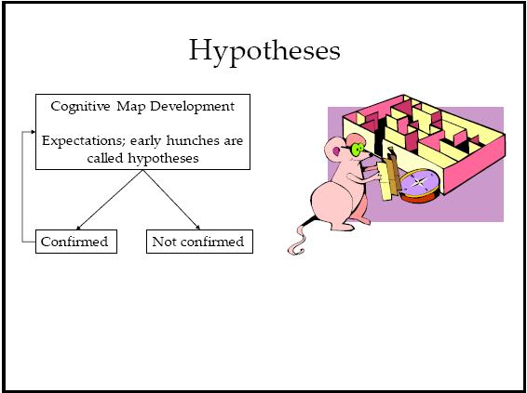
Cognitive (E.C. Tolman)

Slide 11
"Cognitive learning is the result of listening, watching, perceiving or experiencing.“
Cognitive maps are mental representations of the lay out of one’s environment.
Cognitive learning is a powerful mechanism that provides the means of knowledge, and goes well beyond simple imitation of others.

Slide 12
Conditioning
Conditioning is learning by association, it consist in associating one experience with another that is already familiar to us. Two types of conditioning.
Classical Conditioning
Operant Conditioning

Slide 13
Classical Conditioning (Ivan Pavlov)
Classical Conditioning (also Pavlovian or Respondent Conditioning) is a form of associative learning that was firstly demonstrated by Ivan Pavlov .
The typical procedure for inducing classical conditioning involves presentations of a neutral stimulus along with a stimulus of some significance.
The neutral stimulus could be any event that does not result in an overt behavioral response from the organism under investigation. Pavlov referred to this as a Conditioned Stimulus (CS).
Conversely, presentation of the significant stimulus necessarily evokes an innate, often reflexive, response. Pavlov called these the Unconditioned Stimulus (US) and Unconditioned Response (UR), respectively.
If the CS and the US are repeatedly paired, eventually the two stimuli become associated and the organism begins to produce a behavioral response to the CS. Pavlov called this the Conditioned Response (CR).

Slide 14
Stimuli & Responses
Acquisition
Extinction
Spontaneous Recovery
Generalization
Discrimination

Slide 15
Extinction
A basic phenomenon of learning that occurs when previously conditioned response decreases in frequency and eventually disappears.

Slide 16
Spontaneous Recovery
The reemergence of an extinguished conditioned response after a period of rest and with no further conditioning.

Slide 17
Generalization
Tendency to respond to a stimulus that is similar to but different from a conditioned stimulus.

Slide 18
Discrimination
The ability to differentiate between stimuli.

Slide 19
Other Observations Made by Pavlov
Stimulus Generalization: Once the dog has learned to salivate at the sound of the bell, it will salivate at other similar sounds.
Extinction: If you stop pairing the bell with the food, salivation will eventually cease in response to the bell.
Spontaneous Recovery: Extinguished responses can be "recovered" after an elapsed time, but will soon extinguish again if the dog is not presented with food.
Discrimination: The dog could learn to discriminate between similar bells (stimuli) and discern which bell would result in the presentation of food and which would not.
Higher-Order Conditioning: Once the dog has been conditioned to associate the bell with food, another unconditioned stimulus, such as a light may be flashed at the same time that the bell is rung. Eventually the dog will salivate at the flash of the light without the sound of the bell.

Slide 20
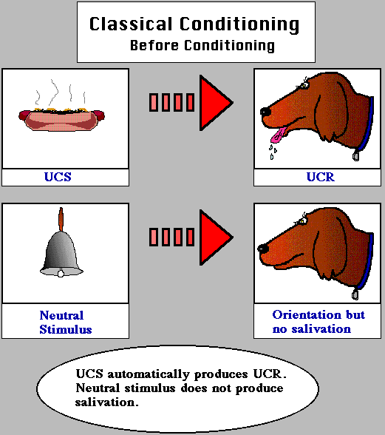
Unconditional

Slide 21
In order to have classical or respondent conditioning, there must exist a stimulus that will automatically or reflexively elicit a specific response. This stimulus is called the Unconditioned Stimulus or UCS because there is no learning involved in connecting the stimulus and response.

Slide 22
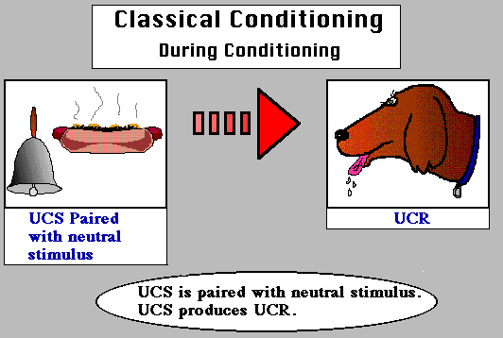
During Conditioning

Slide 23
During conditioning, the neutral
stimulus will first be presented,
followed by the unconditioned
stimulus. Over time, the learner will
develop an association between
these two stimuli (i.e., will learn to
make a connection between the two
stimuli)

Slide 24
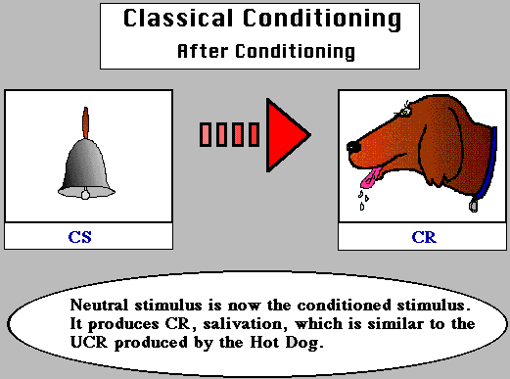
After Conditioning

Slide 25
After conditioning, the previously neutral or orienting
stimulus will elicit the response previously only elicited by
the unconditioned stimulus. The stimulus is now called a
conditioned stimulus because it will now elicit a different
Response as a result of conditioning or learning. The
response is now called a conditioned response because
it is elicited by a stimulus as a result of learning.

Slide 26
Watson's Experiment
Watson demonstrated classical conditioning in an experiment involving a young child (Albert) and a white rat. Originally, Albert was unafraid of the rat; but Watson created a sudden loud noise whenever Albert touched the rat. Because Albert was frightened by the loud noise, he soon became conditioned to fear and avoid the rat. The fear was generalized to other small animals. Watson then "extinguished" the fear by presenting the rat without the loud noise. Some accounts of the study suggest that the conditioned fear was more powerful and permanent than it really was.

Slide 27
His work demonstrated the role of conditioning in the development of emotional responses to certain stimuli. This may explain certain fears, phobias and prejudices that people develop.

Slide 28
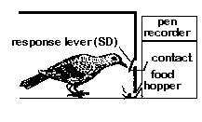
Operant Conditioning:
(B.F. Skinner)

Slide 29
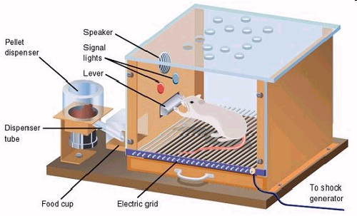

Slide 30
Skinner learned through experimentation that behaviour can be conditioned by using both positive and negative reinforcement. Positive reinforcement conditions the mouse to find the end of the maze in this illustration. The mouse is rewarded with food when it reaches the first turn in the maze (A). Once the first kind of behaviour becomes ingrained, the mouse is not rewarded until it makes the second turn (B). After many times through the maze, the mouse must reach the end of the maze to receive its reward (C).

Slide 31
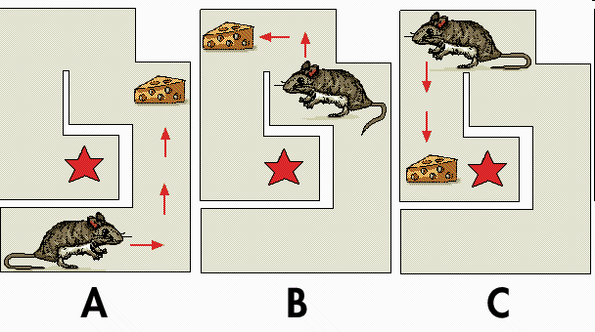

Slide 32
Operant conditioning can be defined as a type of learning in which voluntary (controllable; non-reflexive) behavior is strengthened if it is reinforced and weakened if it is punished (or not reinforced).
For Example, to get an animal to learn how to press a lever, the experimenter will use small rewards after each behavior that brings the animal toward pressing the lever. So, the animal is placed in the box. When it takes a step toward the lever, the experimenter will reinforce the behavior by presenting food or water in the dish (located next to or under the lever). Then, when the animal makes any additional behavior toward the lever, like standing in front of the lever, it is given reinforcement (note that the animal will no longer get a reward for just taking a single step in the direction of the lever). This continues until the animal reliably goes to
the lever and presses it to receive reward.

Slide 33
Reinforcement, punishment, and Extinction
Reinforcement is a consequence that causes a behavior to occur with greater frequency.
Punishment is a consequence that causes a behavior to occur with less frequency.
Extinction is the lack of any consequence following a behavior.

Slide 34
Positive reinforcement occurs when a behavior (response) is followed by a favorable stimulus (commonly seen as pleasant) that increases the frequency of that behavior. In the Skinner box experiment, a stimulus such as food or sugar solution can be delivered when the rat engages in a target behavior, such as pressing a lever.
Negative reinforcement occurs when a behavior (response) is followed by the removal of an aversive stimulus (commonly seen as unpleasant) thereby increasing that behavior's frequency. In the Skinner box experiment, negative reinforcement can be a loud noise continuously sounding inside the rat's cage until it engages in the target behavior, such as pressing a lever, upon which the loud noise is removed.

Slide 35
Positive punishment (also called "Punishment by contingent stimulation") occurs when a behavior (response) is followed by an aversive stimulus, such as introducing a shock or loud noise, resulting in a decrease in that behavior
Negative punishment (also called "Punishment by contingent withdrawal") occurs when a behavior (response) is followed by the removal of a favorable stimulus, such as taking away a child's toy following an undesired behavior, resulting in a decrease in that behavior

Slide 36
How to deal with children?
The best way to reduce misbehavior is to provide abundant positive reinforcement for good behavior. Punishment in the form of unpleasant consequences might stop misbehavior, but it often has undesirable side effects. A child whose behavior is punished may react emotionally, strike back or avoid the person delivering the punishment. Instead of punishing misbehavior, try to catch your child being good. Tell her that you appreciate what she's doing, and do so frequently and consistently. At the same time, make sure misbehavior doesn't pay off by enabling your child to avoid homework or chores, for example, or to gain attention.

Slide 37
Factors Influencing Learning
Motivation
Reward and Punishment
Interest
Group Participation
Amount
Familiarity
Meaningfulness

Slide 38
Motivation:
Learning is greatly influenced by the level of aspiration
and nature Of achievement motivation is posed by the
learner. How can we expect from a learner to achieve a
thing for which he has no aspiration?
One has to maintain the level of his aspiration and
achievement motivation to a reasonable level neither to
high causing frustration for non achievement nor too
low as not to try for thing for which he is quite capable.

Slide 39
Reward & Punishment:
The learning yields are much dependent upon the
nature and quality of Feedback and reinforcement
provided to the learner in his learning task.
These results are un match able so simple
reinforcement technique In the shape of approval are
,nodding of head ,smiling ,saying good bye etc...

Slide 40
Interest or Goal of Life:
The philosophy and immediate as well as
ultimate goals of one's life effect the process
and products of learning.
One’s mode and ways of looking towards the
things , one’s inclination towards learning in a
particular area and patience and persistence
maintained for continuing one’s learning despite
the heavy odds all depend upon his goal and
philosophy of life.

Slide 41
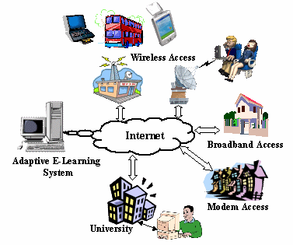
Environmental Factors:
In the process of teaching &
learning whatever exists
besides the personal
factor involving the self of
the learner may included in
the boundaries of
environmental factors
influencing learning.

Slide 42
Many More Factors:
There are many more factors which effect the learner
or helps him in learning like………
Group participation
Amount
Familiarity
Meaningfulness
The basic potential of a learner
Learner's physical and mental health
Readiness and willpower
The nature of learning experience
The methodology of learning experiences
Liking of the new learning with the past, etc…………………

